Slide 1
OPENAI ACADEMY
AI Foundations
Build Practical Skills for Working with AI
~70 minutes
Self-paced
Introduction
DURATION
FORMAT
LEVEL

Slide 2
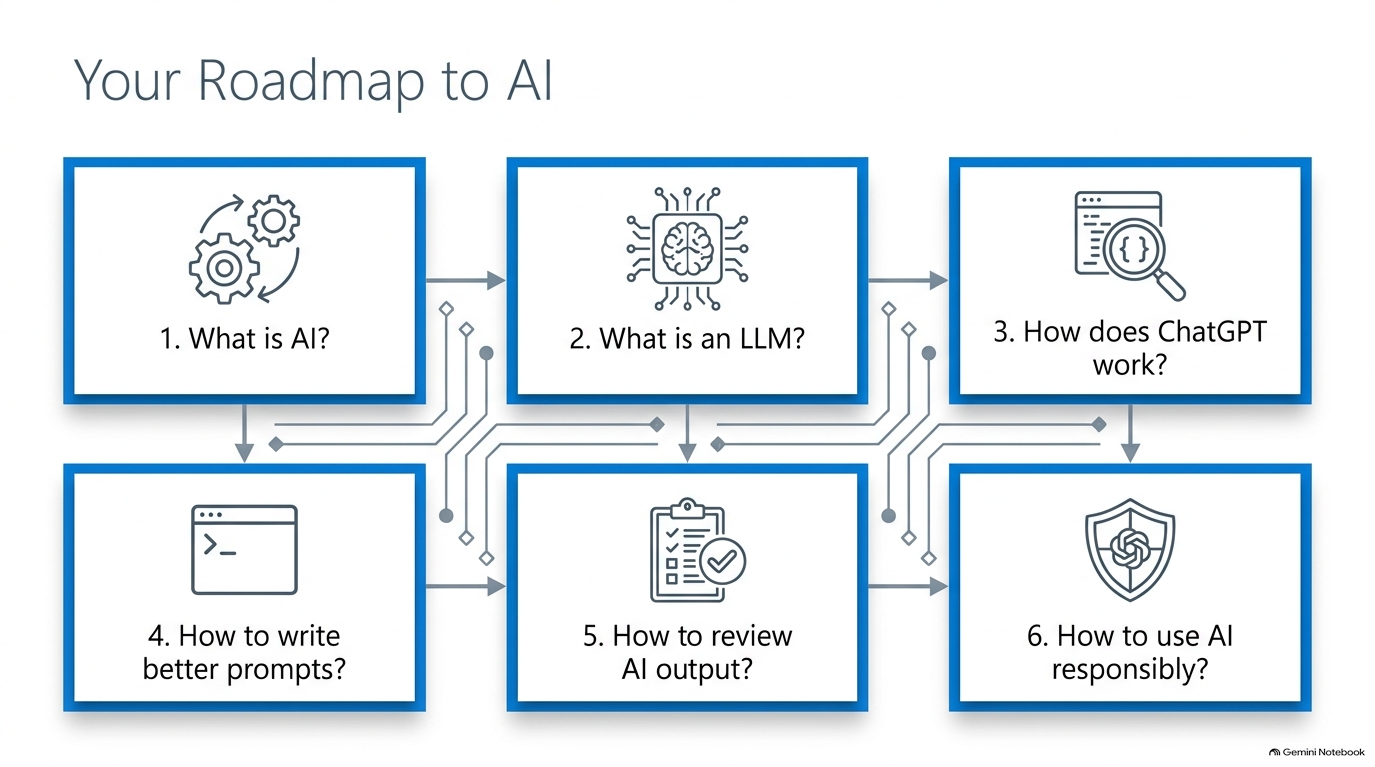

Slide 3
COURSE INTRODUCTION
What Is AI Foundations?
AI Foundations introduces the basic skills needed to work effectively with Artificial Intelligence.
YOU WILL LEARN ABOUT
Artificial Intelligence
Large Language Models
ChatGPT
Prompting
Providing context
Reviewing AI outputs
Responsible use of AI
KEY IDEA
AI is not only about knowing how AI works — it is also about knowing how to work with AI effectively.
AI Foundations — OpenAI Academy
2

Slide 4
COURSE INTRODUCTION
Who Is This Course For?
1
2
3
4
People new to AI
People who want to improve their AI skills
Students and professionals
People who want to use AI effectively at work
NO TECHNICAL BACKGROUND REQUIRED
WHAT YOU NEED
You do not need:
Programming knowledge
Advanced mathematics
Machine learning expertise
✓
A ChatGPT account
✓
A real task to practice with
AI Foundations — OpenAI Academy
3

Slide 5
COURSE INTRODUCTION
What Will You Learn?
The course focuses on four practical AI skills.
1
2
3
4
Give Clear Instructions
Provide Context
Review the Output
Use AI Responsibly
→
→
→
Tell AI exactly what you want.
Give AI the information it needs.
Check whether the response is accurate and useful.
Keep human judgment and responsibility in the process.
AI Foundations — OpenAI Academy
4

Slide 6
COURSE OVERVIEW
Approximately 70 Minutes
The learning path is designed to be completed in about 70 minutes.
LEARNING APPROACH
1
2
3
4
Learn
Practice
Review
Improve
This cycle repeats as you build confidence with real tasks.
YOU WILL WORK WITH A REAL TASK
You will work with a real task while learning how to use AI effectively — so the skills transfer directly to your own work.
AI Foundations — OpenAI Academy
5

Slide 7
COURSE OVERVIEW
Course Completion
Complete the course
1
Complete the assessment
2
Score at least 80%
3
Earn your OpenAI Academy course badge
★
AI Foundations — OpenAI Academy
6

Slide 8
GETTING STARTED
How to Take the Course
1
2
3
Interactive Learning
Choose a Practice Task
Remember
Keep ChatGPT available while learning
Try different prompts, instructions, context, and AI features
Drafting an email
Summarizing notes
Explaining a concept
Planning a meeting
Brainstorming or organizing
Do not use sensitive, private, or confidential information for practice
AI Foundations — OpenAI Academy
7

Slide 9
UNDERSTANDING AI AND LLMS
What Is AI?
Recognize patterns
AI
1
Make predictions
2
Artificial Intelligence
A broad category of computer systems.
Generate or organize information
3
It can:
AI Foundations — OpenAI Academy
8

Slide 10
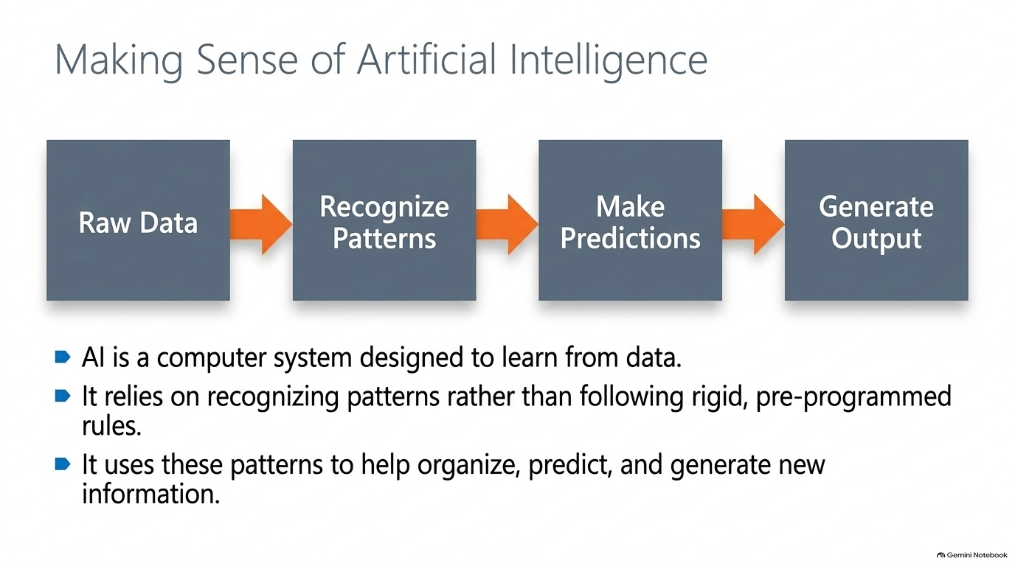

Slide 11
UNDERSTANDING AI AND LLMS
What Is an LLM?
LLM
Large Language Model
A type of AI that works with language.
HOW AI AND LLMS RELATE
Artificial
Intelligence
Large Language
Models (LLMs)
GPT
includes
powers
AI Foundations — OpenAI Academy
9

Slide 12
UNDERSTANDING AI AND LLMS
What Is ChatGPT?
An OpenAI product that makes an LLM easier to use.
INCLUDES FEATURES SUCH AS
File uploads
Search
Personalization
Image generation & editing
Code extraction
Data analysis
Safety features
AI Foundations — OpenAI Academy
10

Slide 13
UNDERSTANDING AI AND LLMS
What Can LLMs Do?
Your Prompt
LLM
Drafted / Explained / Organized Response
COMMON TASKS
Drafting
Summarizing
Explaining
Planning
Brainstorming
Organizing
AI Foundations — OpenAI Academy
11

Slide 14
UNDERSTANDING AI AND LLMS
How LLMs Generate Responses
1
2
3
Prediction, Not Retrieval
→
Step-by-Step Generation
→
Continuous Context
The model does not simply retrieve a stored answer.
It predicts what word or phrase is likely to come next.
Each generated word becomes part of the context for the next prediction.
Each word feeds back into the context for the next prediction
AI Foundations — OpenAI Academy
12

Slide 15
UNDERSTANDING AI AND LLMS
How AI Models Are Trained
“Learn” means recognizing and using patterns in data — different from human learning, thinking, or understanding.
1
2
3
4
Pre-training
Post-training
Product Experience
Ongoing Feedback
Learns basic language and patterns from large amounts of text.
Refines the model to be more helpful and conversational.
The trained model is incorporated into products such as ChatGPT.
Models are improved through research and user interactions.
AI Foundations — OpenAI Academy
13

Slide 16
WORKING WITH AI CORRECTLY
Know When to Use Trusted Sources
CORE PRINCIPLE
Use ChatGPT as a workspace, not as a source of truth.
RECOMMENDED WORKFLOW
1
2
3
Start with a trusted source, file, or web search.
Provide the source material to ChatGPT.
Ask ChatGPT to summarize, explain, checklist, draft, or compare.
USE TRUSTED SOURCES FOR
Current facts
Policies / legal guidance
Prices
Dates
Schedules
Citations
Links
Exact source material
AI Foundations — OpenAI Academy
14

Slide 17
WORKING WITH AI CORRECTLY
Why AI Needs Human Review
AI-GENERATED RESPONSES CAN BE...
⚠
Incomplete
Hallucination
Outdated
A plausible, confident-sounding AI response that is not properly grounded in the correct information.
Incorrect
Confident-sounding without sufficient support
SOLUTION
Provide clear context and sources.
Review the AI output using your own judgment.
PRACTICAL LIMITS
Knowledge Gaps — AI may not know recent events or private information.
Response Variation — the same prompt may produce slightly different responses.
AI Foundations — OpenAI Academy
15

Slide 18
WORKING WITH AI CORRECTLY
Generate → Ground → Review
1
Generate
2
Ground
3
Review
Drafting
Explaining
Brainstorming
Organizing
Provide context
Provide files
Provide trusted sources
Use search
Accuracy
Fit
Completeness
Source support
→
→
Golden Rule: Give AI enough direction to help you, then apply your own human judgment.
AI Foundations — OpenAI Academy
16

Slide 19
WRITING BETTER PROMPTS
Two Habits for Better Prompting
2
Review the Work
1
Direct the Work
Treat AI output as a first draft. Use the CLEAR structure:
Use:
Task
C
Complete
+
L
Logical
Context
+
E
Evidence
Expectation
A
Audience
A vague prompt makes AI guess. A clear prompt specifies the task, audience, tone, length, and expected output.
R
Relevant
AI Foundations — OpenAI Academy
17

Slide 20
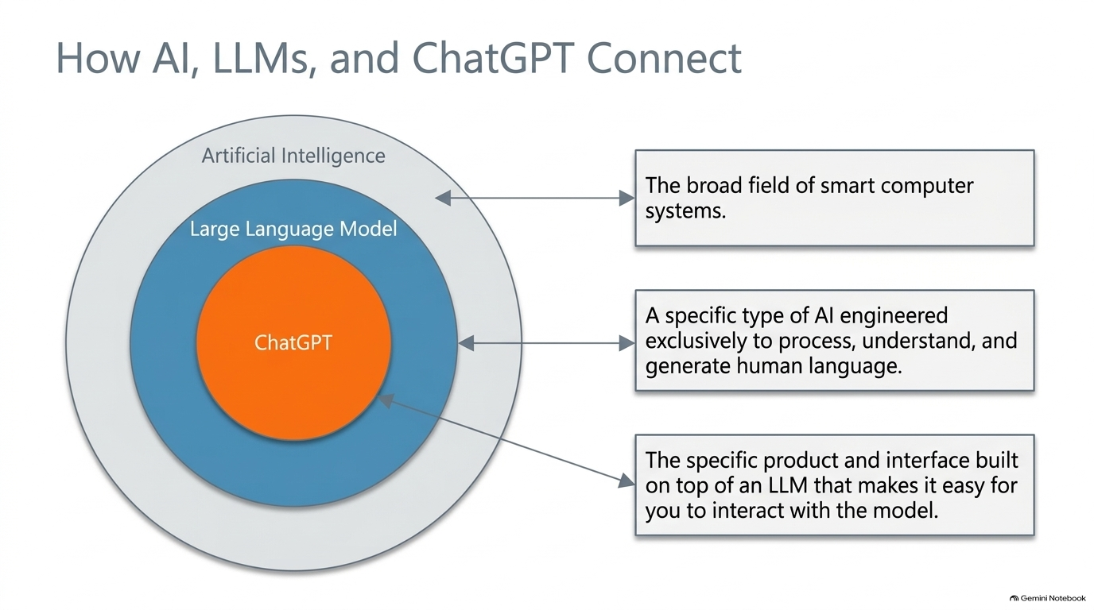

Slide 21
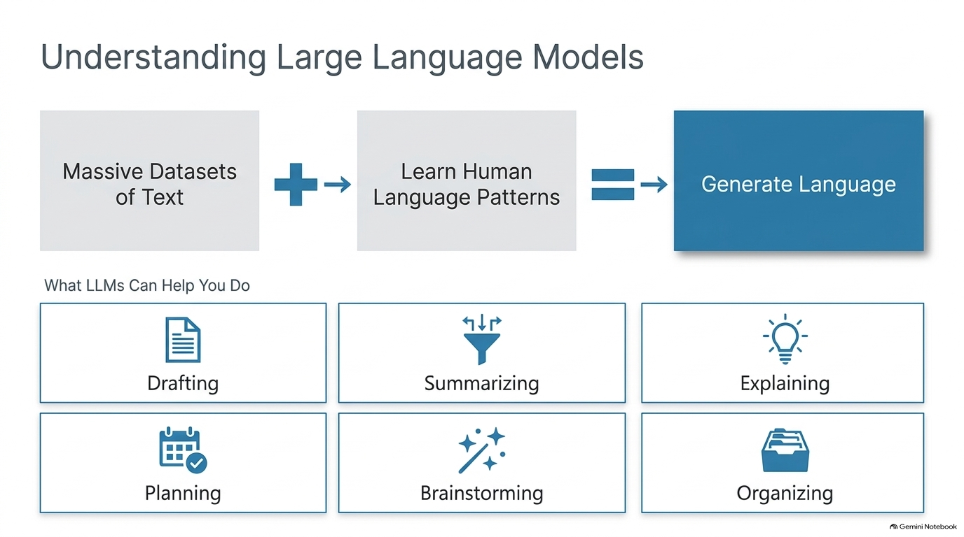

Slide 22
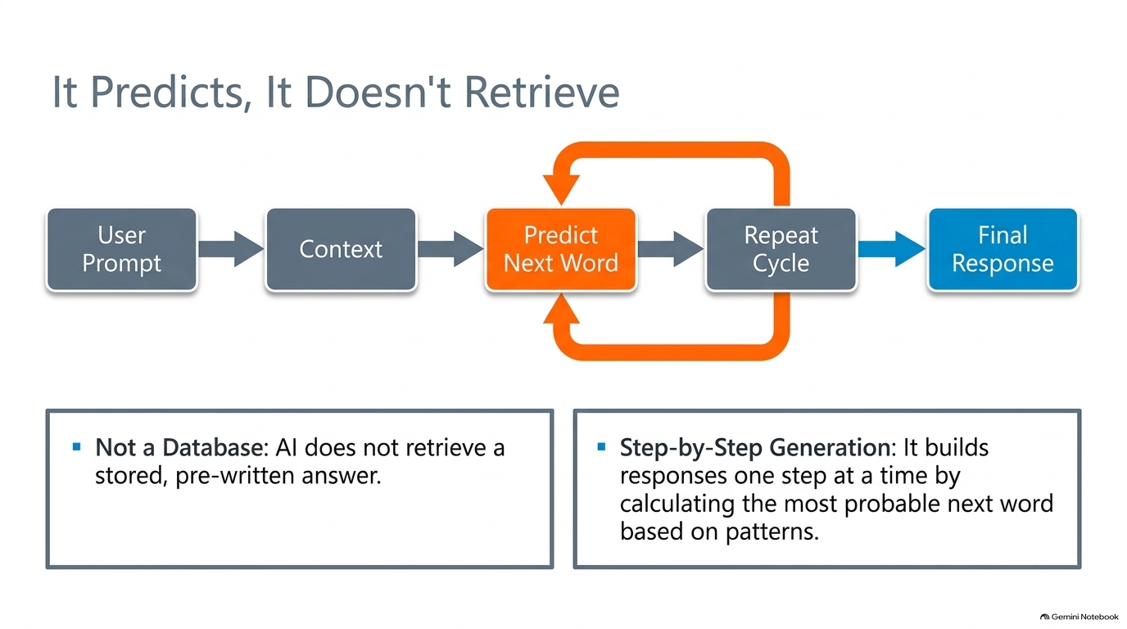

Slide 23
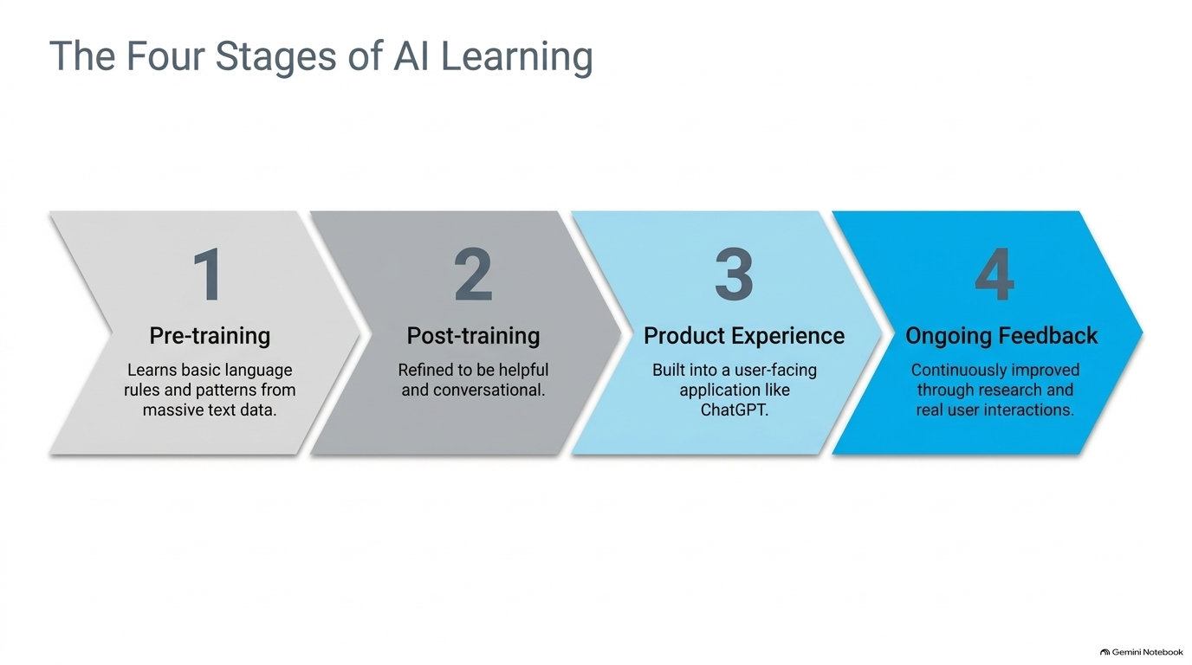

Slide 24
THE POWER OF CONTEXT
The Power of Context
Context helps ChatGPT understand your goals, source material, audience, and preferred way of working.
THREE CONTEXT QUESTIONS
?
?
?
What are you trying to do?
What information should ChatGPT use?
What would a good response look like?
Golden Rule: If a teammate would need certain information to complete a task well, ChatGPT probably needs it too.
WHAT TO ADD: Task • Information (background, files, sources, examples, audience, constraints, goals) • Expected Output (format, tone, length, sections, criteria)
AI Foundations — OpenAI Academy
18

Slide 25
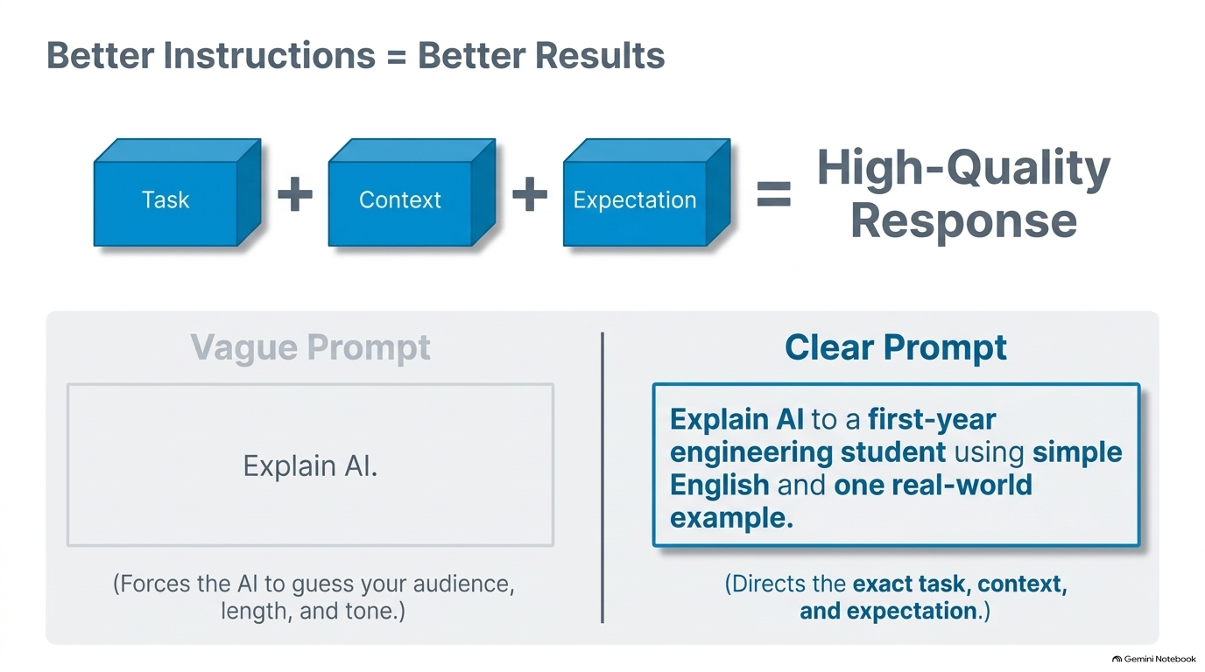

Slide 26
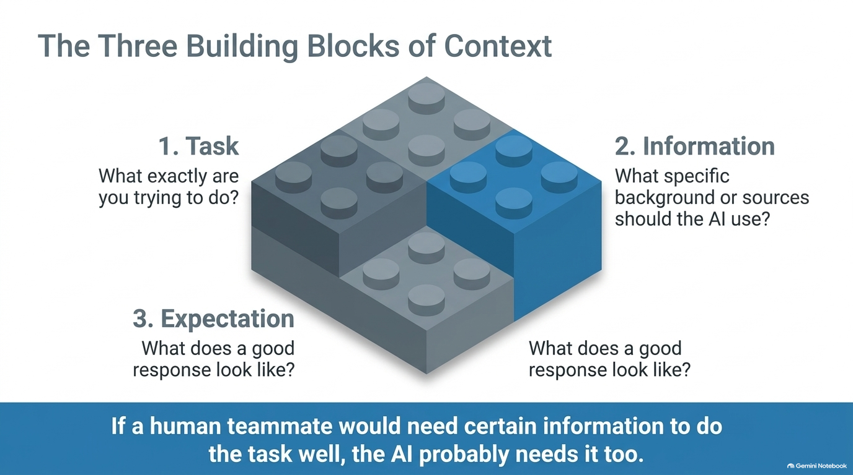

Slide 27
CHOOSING THE RIGHT CONTEXT SOURCE
Files, Search, and Saved Preferences
F
S
M
Use Files
Use Search
Save Preferences
Report → summarize findings
Spreadsheet → find trends
Policy → build a checklist
Notes → capture decisions
Recent, external, public
Time-sensitive info
Citations & comparisons
Search ≠ human judgment
Input — a single task
Custom Instructions — recurring style
Memory — role & ongoing context
AI Foundations — OpenAI Academy
19

Slide 28
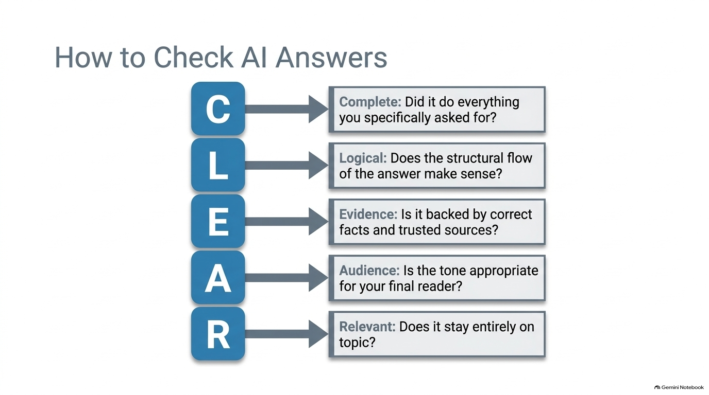

Slide 29
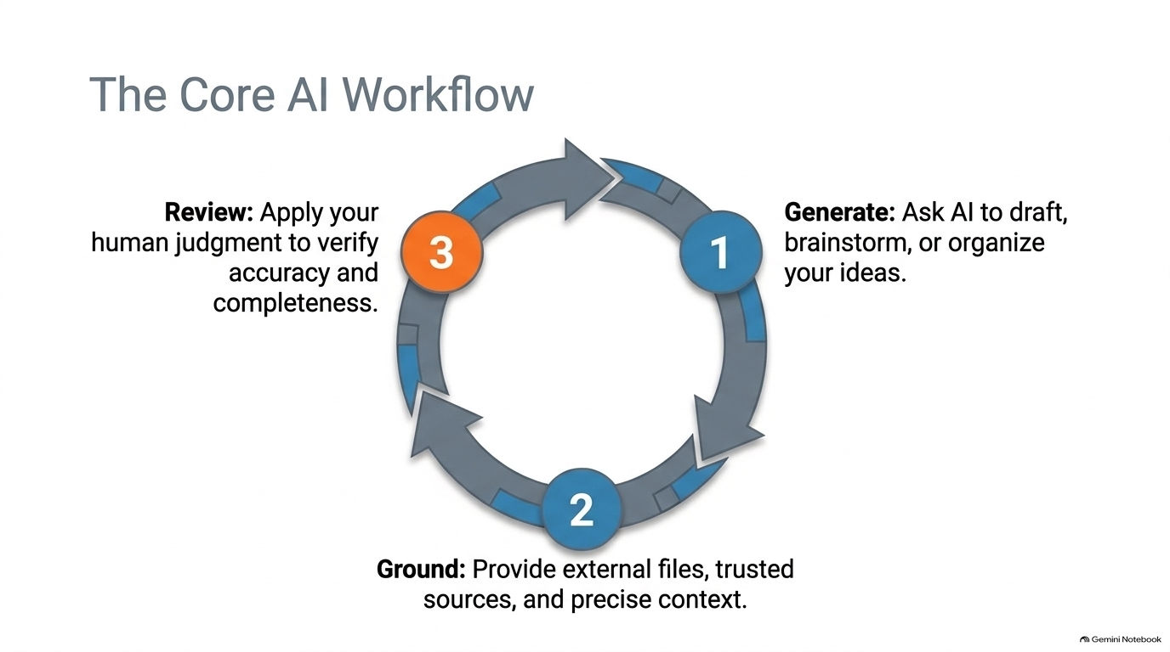
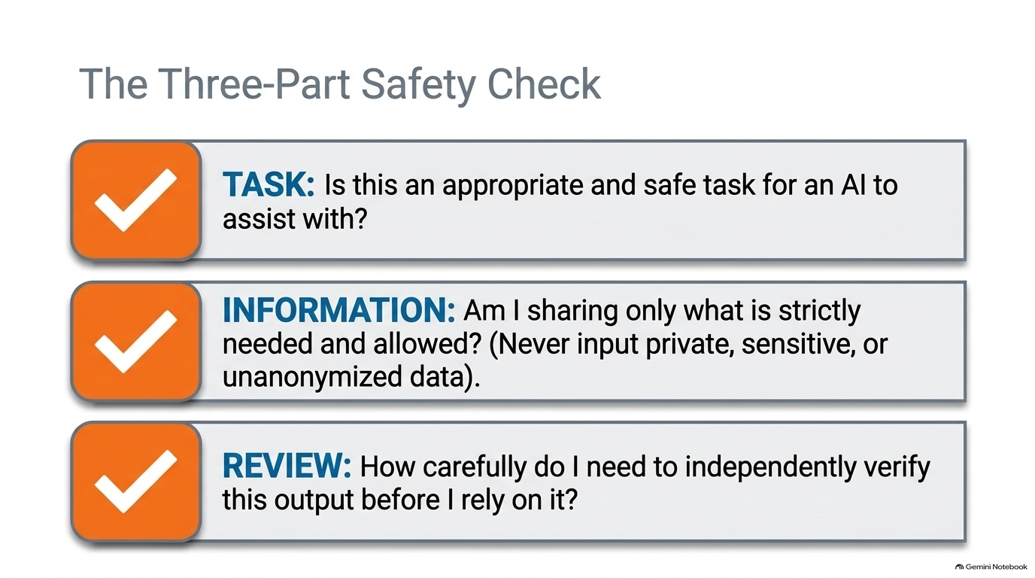

Slide 30
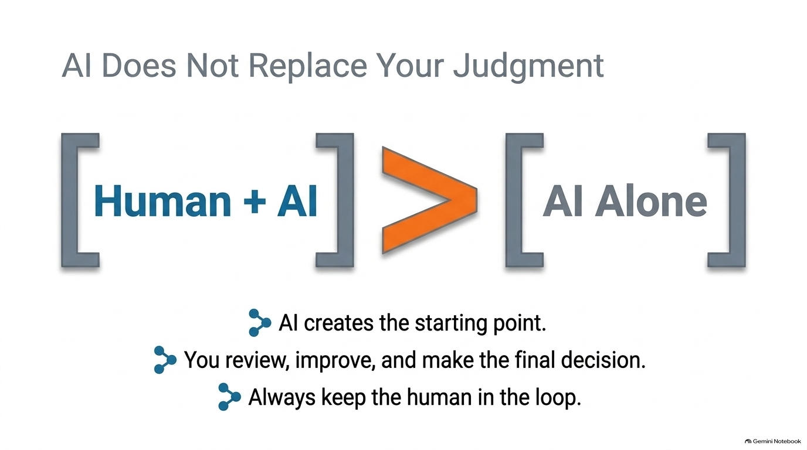

Slide 31
RESPONSIBLE AI USE
The Three-Part Quick Check
1
2
3
Task
Information
Review
Is this appropriate for ChatGPT?
Am I sharing only what is needed and allowed?
How carefully should a human check the output?
Bottom line: ChatGPT can improve efficiency and support thinking — but you remain in control.
You're Ready
Complete the assessment and score at least 80% to earn your OpenAI Academy course badge.
Instruct → Context → Review → Responsibility

